Slide 1
Oxfam Surveys

Slide 2
Introduction

Slide 3
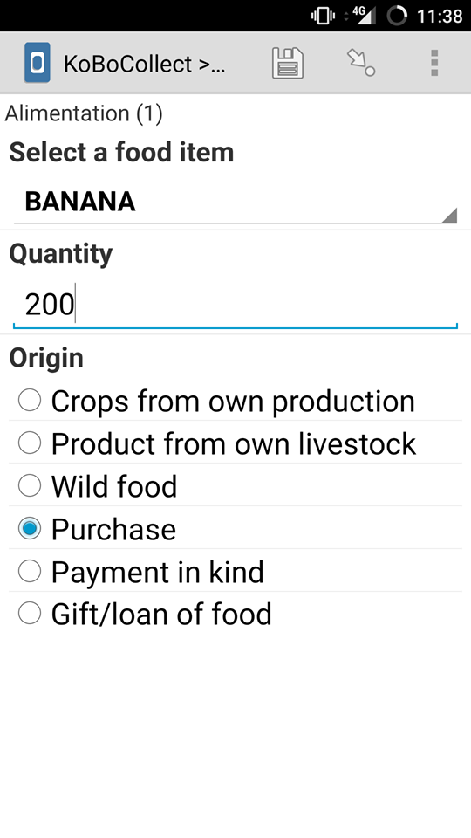
What?
KoboCollect App
Uploads data when device has connection

Slide 4
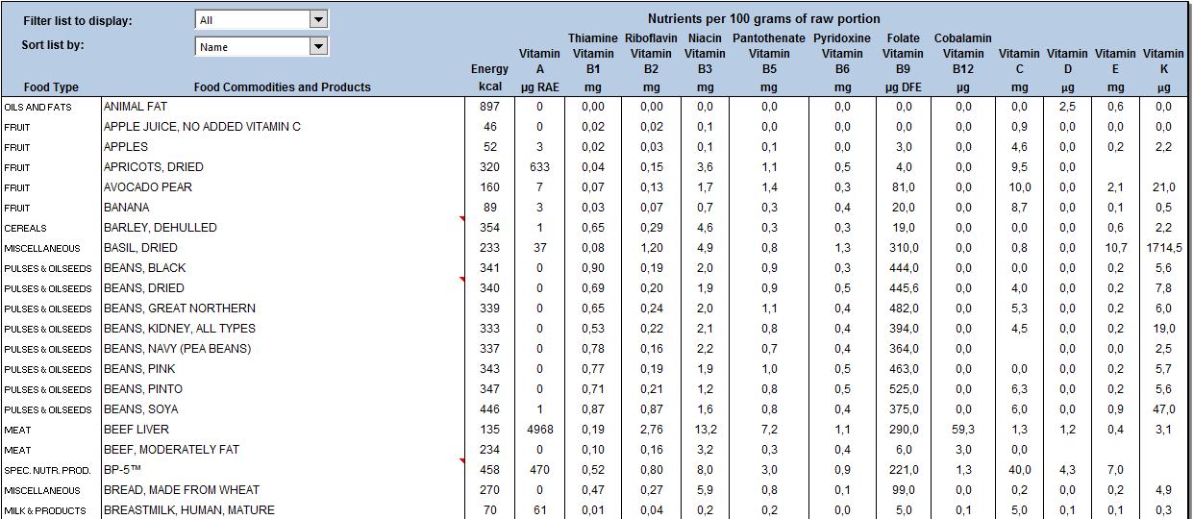
What?
Linked with the
Database of foods

Slide 5
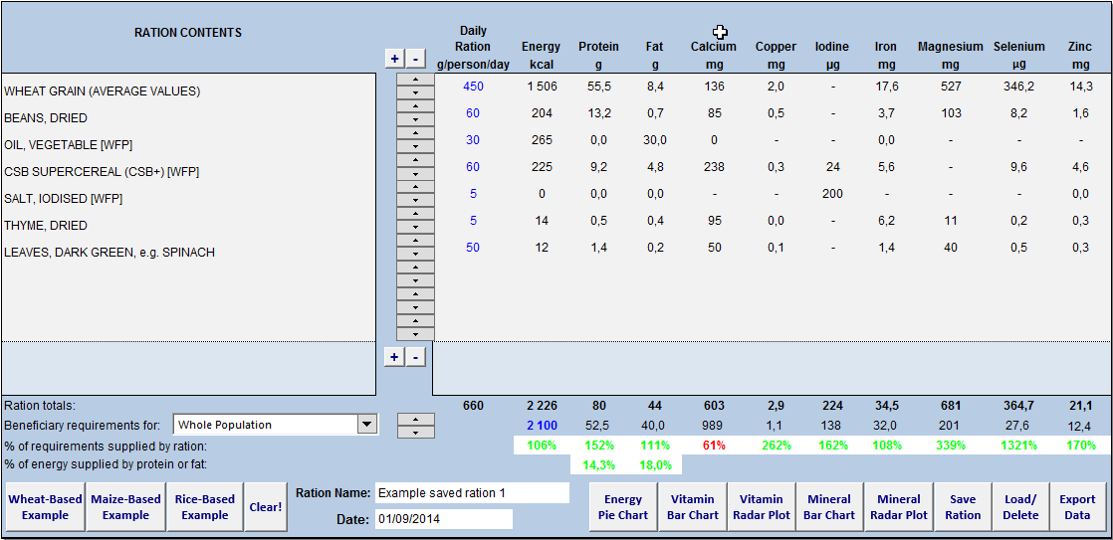
What?
For use with the
Ration Calculator

Slide 6
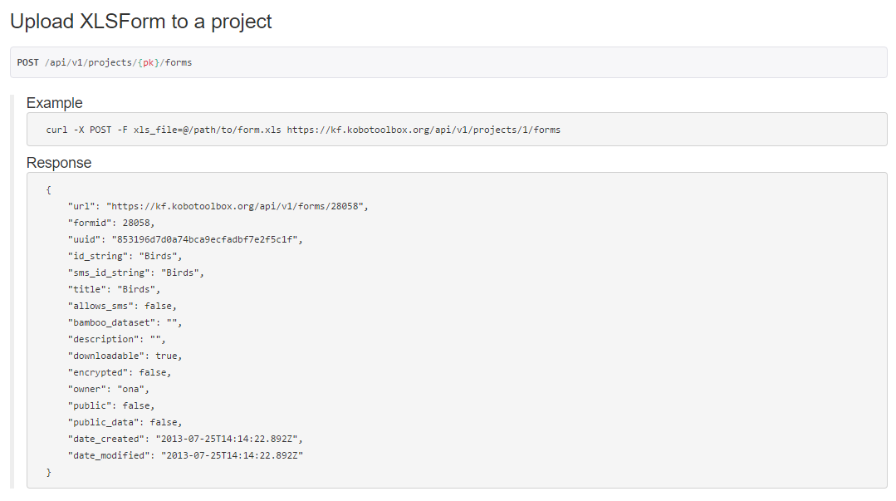
How?
Data is sent with KoBo Api
Using Excel forms

Slide 7
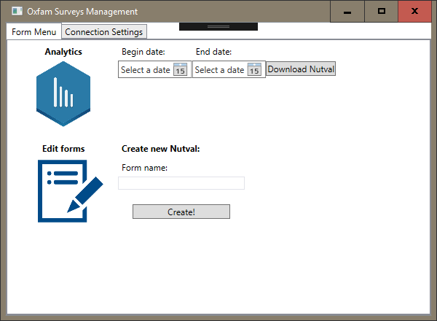
How?
Read data from the form
Feed it into our application

Slide 8
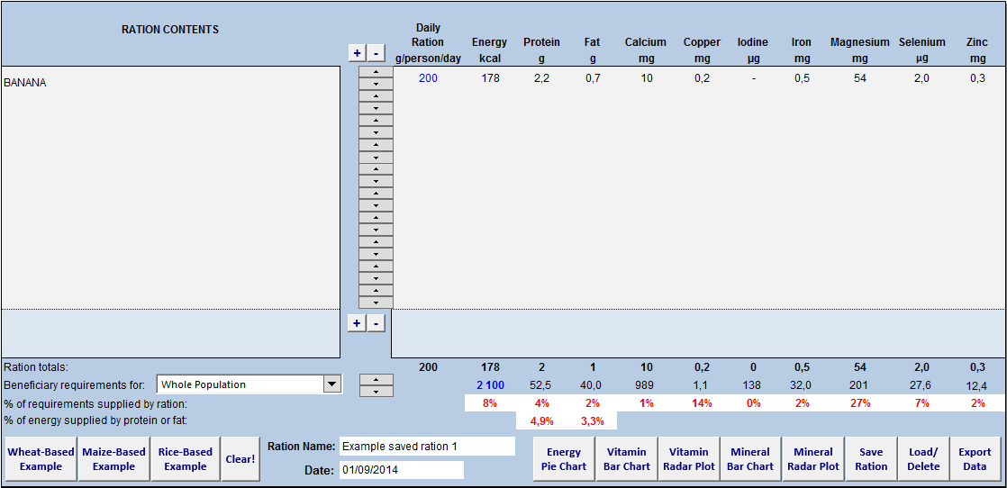
How?
Application processes the data
Inserts data into the ration calculator

